Slide 1
The Moon Village
“A place to test new ways of living and working, and prepare the next exploration steps”

Slide 2
What is the Moon Village ?
Moon Village is a common destination for multiple users and multiple uses where different organizations from different nations could collaborate together for sustainable operations on Moon surface as well as cis-lunar space
It is not a literal village on the Moon, it is not an International Space Station on the Moon
As an ultimate goal the Moon Village will be a human community on and around the Moon, where people share needs, infrastructures, resources, with the aim of nearly autonomous operations, for different collective or individual purposes
The Moon Village will start with scouting expeditions, on or around the Moon, with robots and then humans
Key infrastructure segments will be progressively implemented on the Moon surface or in lunar orbits
When time will come for mature operations, the Moon Village bases will be built at optimal sites on various regions of the Moon, starting with small centers

Slide 3
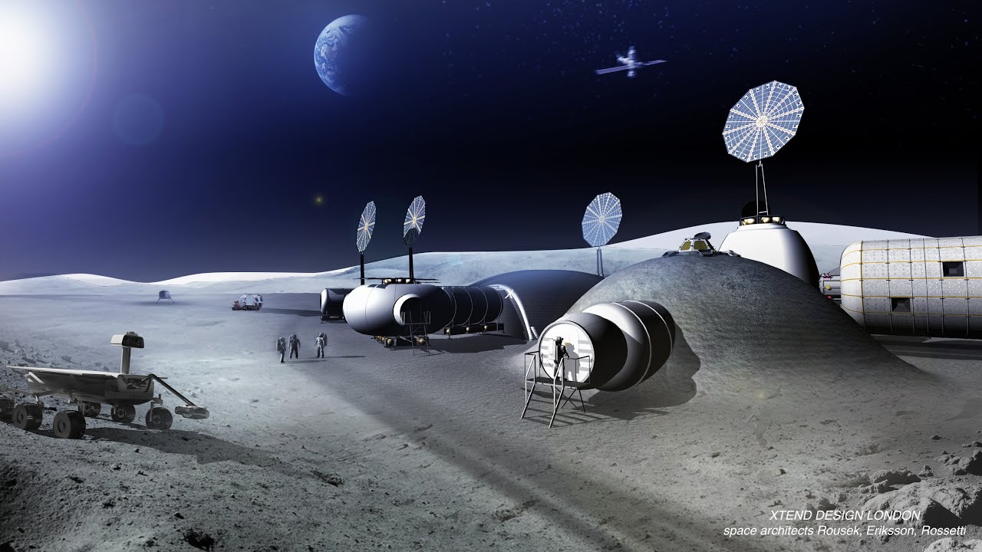
The major interests of the Moon Village
A catalyst for government, scientific research, education and industry activities, all involved in the building of the infrastructures, thus stimulating a virtuous cycle for the development of a lunar economy
Open to permanent global cooperation between countries in the world, thus contributing to world peace
A major inspirational role for the society and in particular for young generations that will see an open ended future full of possibilities in a totally new environment with an Overview Effect on our fragile Earth
Provide major indications on the possibility to become independent from Earth resources, and to prepare self-sustaining exploration of other planets like Mars

Slide 4
What to do in the Moon Village ? (1/2)
Science :
Fundamental research on the Moon (e.g. geology), astronomy from the Moon, and exploration of the universe.
Both big and small science, for professional scientists and amateur science fans
Strong inspirational and education tool for younger generations.
Surface Exploration :
A lot of unknown places on the Moon surface, in particular on the far side
Both scientific and economical objectives (search for in-situ resources)
May evolve later towards entertainment and “extreme sport”.
Technology development :
Booster for new technologies : energy supply and frugal consumption, sustainable water, atmosphere and food supply and recycling, protection against radiations, communication, navigation, construction, transportation and logistics management, etc.
Optimization of joint man/robots operations
Preparation of further exploration steps (Mars expeditions)
Possible answers some fundamental issues on the Earth, regarding frugal operations, sustainability, environment, and energy and key resources management

Slide 5
What to do in the Moon Village ? (2/2)
Resources Utilization :
Mining, processing and use of lunar resources
For the benefit of the Moon Village
For the benefit of other applications (further exploration steps, applications on Earth)
Space surveillance :
Observation of outer space
Surveillance and detection of NEOs, for the protection of the Earth against this threat
Entertainment :
Very attractive place for the entertainment industry
Offer to wealthy people looking for very “exotic” and extreme sensations
Tourism, sports, racing, shows, arts, etc.
Support to the infrastructure and the operations :
Activities for the building and then sustainable operations of the Moon
Robust recurring business by private operators : construction, energy, transportation, logistics management, air/water/food management and supply, etc.

Slide 6
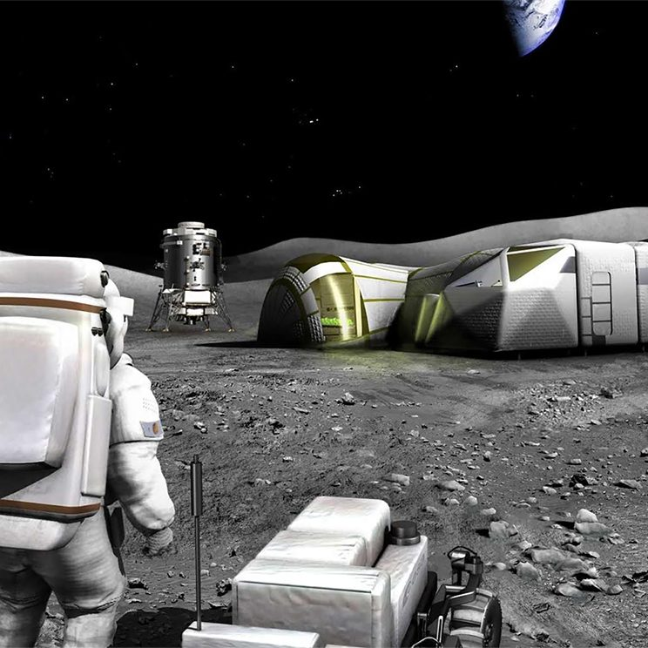
A unique test bed to work and live differently, and find solutions for the Earth challenges !
The Moon Village will rally a broad variety of communities (nations, organizations, individuals) which shall work and live in good harmony, peacefully and respecting the values of mankind
A specific operations mode shall be defined to drive smoothly the Moon Village in all its dimensions
The respective roles and duties of humans and machines shall be optimized, thus defining a new frame for this cohabitation
The respective roles and duties of humans and machines shall be optimized, thus defining a new frame for this cohabitation
Creative business models shall be invented, mixing various financing streams from diverse sources (public, private institutions, individuals, etc.).
The Moon Village will be a scale one test bed for a human community to reinvent and experiment new ways of living and working, which might be set up on Earth, to improve living conditions and planet sustainability

